Slide 1




Slide 2
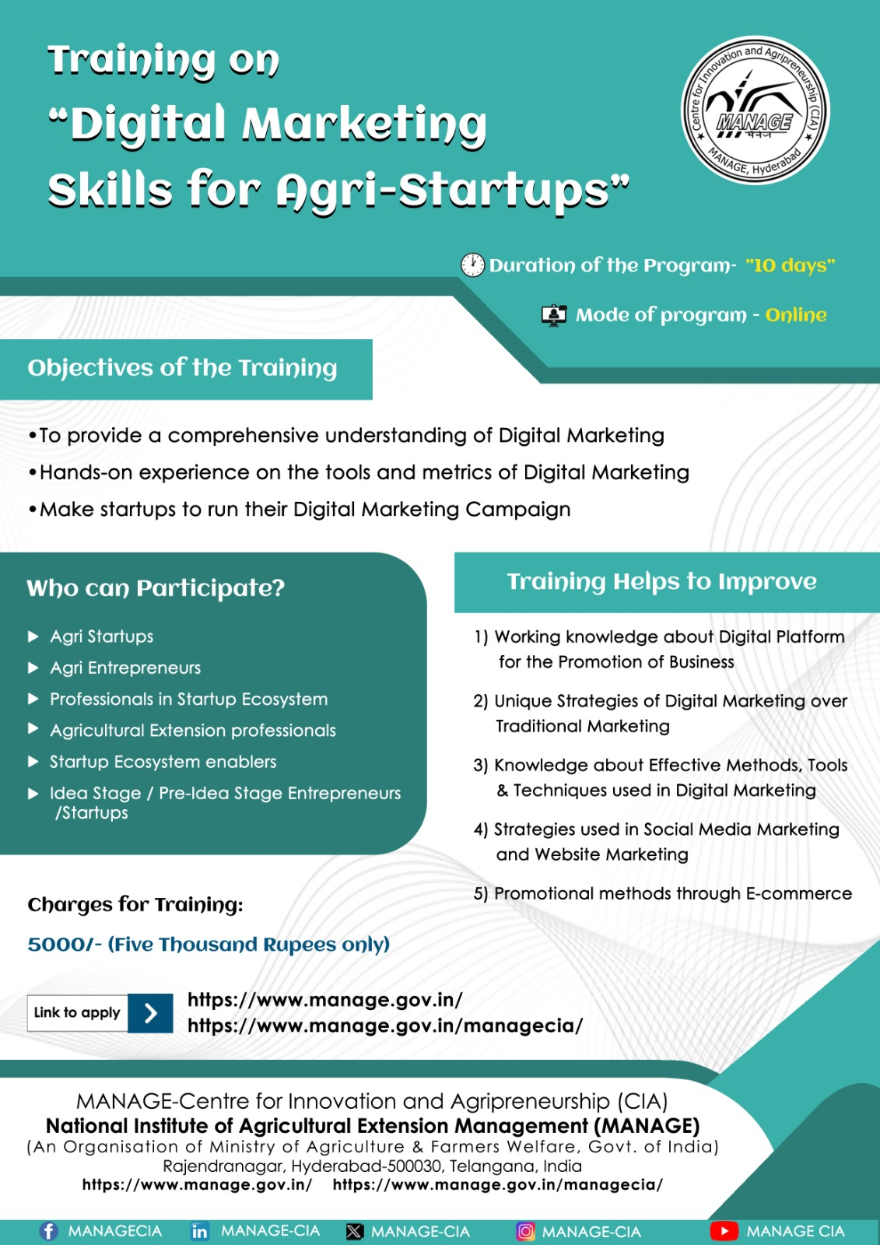
Program Overview
Title: Digital Marketing Skills for Agri-Startups
Mode: Online
Organized by: Centre for Innovation and Agripreneurship (CIA), MANAGE
Participants: 214 till 8th batch
Eligible Participants – Agripreneurs, Students, Researchers and Agri-Professionals
Program Objectives:
Equip startups with foundational digital marketing knowledge
Enable use of technical tools (SEO, SEM, analytics, websites)
Build platform proficiency (Social media, email, content creation)
Develop engagement & branding strategies for rural and digital audiences

Slide 3



By the End of This Program, You Will Be Able To…
Build authentic digital brand presence
Learn hands-on SEO and Content marketing strategies
Gain AI tool proficiency (ChatGPT, Steve AI, Freepik, etc.)
Develop Instagram and Reels growth strategies
Create SEO-optimized websites with clear CTAs
Understand rural outreach via vernacular content & WhatsApp
Receive tailored mentoring to refine startup’s digital approach

Slide 4
Structure of the Program:
Total Duration: 10 Days
7 Days: Group Mentoring Sessions
3 Days: One-on-One Mentoring Sessions

Slide 5


Conclusion:
This 10-day program empowered Participants with strategic skills to boost visibility, connect authentically, and grow in the digital era

Slide 6





Stay Connected with us Online
Connect us
MANAGECIA
managecia
MANAGE-CIA
Manage Cia
ciamanage

Slide 7


THANK YOU!
Thank you for your time. For more details, please connect with us!

